Slide 1
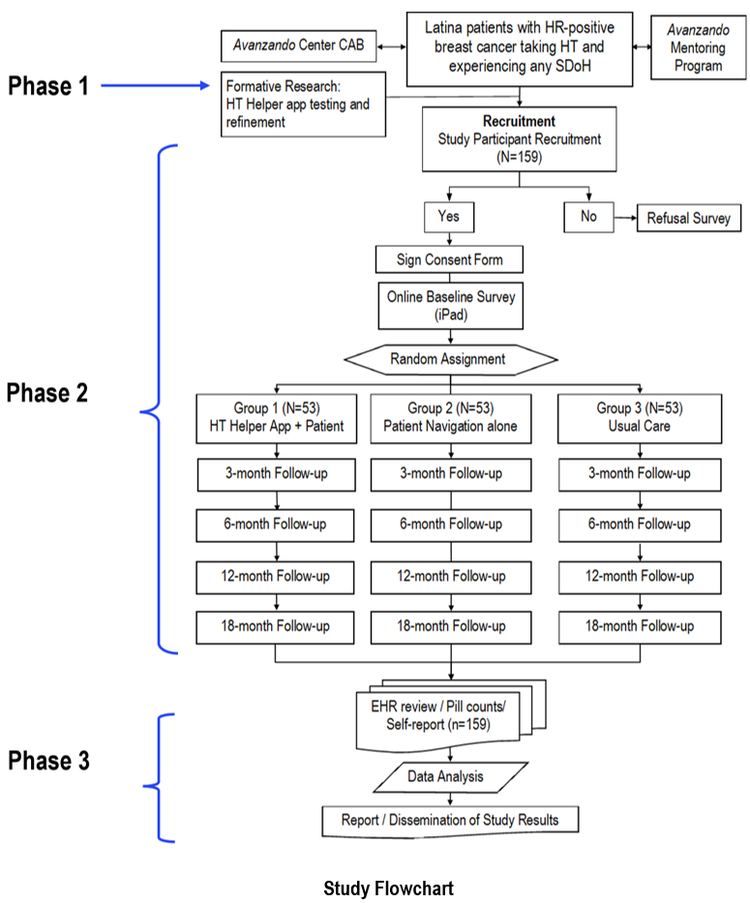
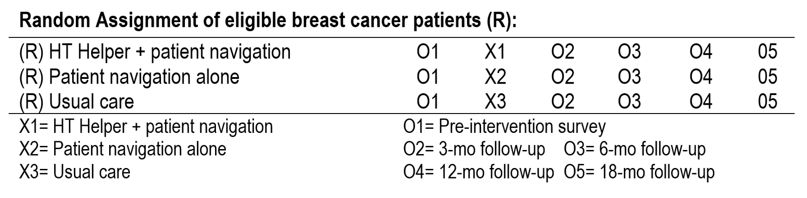

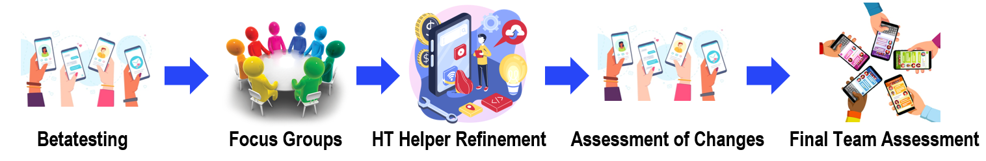
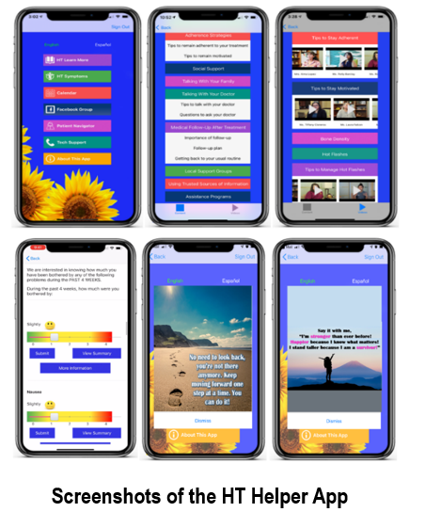
ID P3-01-12
Enhancing Adherence to Hormone Therapy among Latina Breast Cancer Patients Impacted by
Social Determinants of Health through a Bilingual, Culturally Tailored Mobile App and Patient Navigation
Patricia Chalela, DrPH,¹ Vivian Cortez, MS,¹ Sandra Sivak, BS,¹ Armida Flores, BA,¹ Martha De La Mora, BS,¹ Zully Garcia, BS,¹ Byeong Choi, PhD, ¹ Edgar Muñoz, MS,¹ Mauren Duran, BS,¹ Shayannie Sierra,¹ Chastity Garay, ¹
Brittney Millard, ¹ Cliff Despres, BJ,¹ Alyssa Gonzales, BA,¹ Virginia Kaklamani, MD,² Kate Lathrop, MD,² Marcela Mazo Canola, MD,² Devasena Inupakutika, PhD,³ David Akopian, PhD,³ Amelie G. Ramirez, DrPH¹
¹Institute for Health Promotion Research, UT Health SA; ²Mays Cancer Center, UT Health SA; ³University of Texas at San Antonio
INTRODUCTION
MATERIALS AND METHODS
MATERIALS AND METHODS
EXPECTED OUTCOMES
Hormone therapy (HT) is highly effective for nearly all breast cancer patients with hormone receptor-positive tumors, which represent about 83% of all breast cancer diagnoses.^{1,2,3} Long-term use of HT reduces recurrence rates and cuts the risk of breast cancer mortality nearly in half during the second decade after diagnosis. Despite the proven benefits, 33% of women who are prescribed HT do not take it as prescribed by their doctor (<80% take their daily dosage). Latina patients are disproportionately affected by Social Determinants of Health (SDoH) that keep them from adhering to HT and are at higher risk of breast cancer recurrence and mortality.^{4,5}
This parallel 3-group randomized controlled trial with 5-time assessments (baseline, 3, 6, 12, and 18 months) and will enroll 159 breast cancer patients (53/group) who are prescribed HT and are attending the Breast Clinic at the Mays Cancer Center.
Promote health equity by creating a more level playing field that gives underserved Latina breast cancer patients an equitable opportunity to receive the benefits of HT, improve overall survival and life expectancy, enhance quality of life, and decrease cancer healthcare costs.
The intervention can be adapted and tailored to patients’ characteristics and promote health equity among future medically underserved breast cancer patients receiving hormone therapy, regardless of race and ethnicity.
Inclusion Criteria. English/Spanish-speaking Latina patients aged 18 and older who: a) are diagnosed with hormone receptor-positive breast cancer and prescribed HT; b) within 1 to 12 months of starting HT; c) are experiencing any SDoH (Avanzando Center SDoH Screener); d) own a smartphone, are able to send and receive text messages and access the internet; and e) are able to provide informed consent to participate in the study.
Phase 1: Formative Research. Betatesting of the HT Helper App with 12 breast cancer patients experiencing SDoH, who will assess the content, educational videos, and general features of the current app and the app’s User Guide.
CONCLUSION
This proposed multi-level intervention involving a unique combination of mHealth technology + PN has the potential to improve adherence to HT by addressing SDoH and promote equitable breast cancer outcomes, including reduced recurrence and improved quality of life, overall survival and life expectancy among underserved Latina patients. The anticipated outcome is a scalable, evidence-based, and easily disseminated intervention with potentially broad use to patients using oral anticancer medications.
AIM
ACKNOWLEDGEMENTS
The goal of this 4-year randomized controlled study is to assess the effectiveness of the existing bilingual, culturally tailored, interactive HT Helper App, in combination with patient navigation (PN), on improving adherence to HT among Latina breast cancer patients experiencing SDoH barriers, i.e., income, health insurance, education, health literacy, and language, that impacts their medication adherence.
Aim 1: Conduct a parallel 3-group randomized controlled trial to assess the effectiveness of HT Helper App + PN (Group 1) vs. PN alone (Group 2) vs. usual care (Group 3) on HT adherence among Latina patients.
Aim 2: Assess the effect of the HT Helper App + PN (Group 1) vs. PN alone (Group 2) vs. usual care (Group 3) on patients’ self-efficacy to identify side effects, use self-care skills to manage side effects, and communicate with the medical team.
Primary outcome: Adherence to HT (≥80%). We will use pill counts at every visit to calculate an adherence index across the 18-month intervention ((quantity dispensed - remaining)/(quantity prescribed per day*days since last refill))*100.
We will also collect self-report data through the validated Adherence to Refills and Medications Scale (ARMS).
Other primary outcomes of interest are self-efficacy for medication adherence (Self-Efficacy for Appropriate Medication Use Scale - SEAM) and social support (Multidimensional Scale of Perceived Social Support).
Secondary Outcomes: Medication side effects (BCPT Symptoms Scale), patient’s quality of life (Functional Assessment of Cancer Therapy-General – FACT-G), depression (Patient Health Questionnaire – PHQ-8), anxiety (Generalized Anxiety Disorder – GAD-7), and usability and satisfaction with the personalized bilingual mobile application.
This study is funded by the American Cancer Society, under the Avanzando Equidad de Salud: Latino Cancer Health Equity Research Center (Grant Number CHERC-MSI-22-182-01)
REFERENCES
American Cancer Society. Cancer Facts & Figures 2021. Atlanta: American Cancer Society; 2021.
American Cancer Society. Breast Cancer Facts & Figures 2019-2020. Atlanta: American Cancer Society, Inc. 2019.
Brier, M. J., Chambless, D. L., Gross, et al. (2017). Perceived barriers to treatment predict adherence to aromatase inhibitors among breast cancer survivors. Cancer, 123(1), 169–176.
Lin, C., Clark, R., Tu, P., et al. (2017). Breast cancer oral anti-cancer medication adherence: a systematic review of psychosocial motivators and barriers. Breast cancer research and treatment, 165(2), 247–260.
Roberts MC, Wheeler SB, Reeder-Hayes K. (2015).Racial/Ethnic and Socioeconomic Disparities in Endocrine Therapy Adherence in Breast Cancer: A Systematic Review. Am J Public Health. 2015 Jul;105(S3):e4-e15.
This presentation is the intellectual property of the author/presenter. Contact them at (chalela@uthscsa.edu) for permission to reprint and/or distribute.

